Slide 1
“PROJECT PRESENTATION ON” “ADO.NET”
SUBMITTED BY:
ASHWINI KALASKAR(LEAD).
HARSHITHA SK .
LATHESH KUMAR..
GUIDED BY:
SHILPA VAIDYA

Slide 2
CONTENTS:
INTRODUCTION.
CREATING DATABASE.
TABLES CRAETION.
PROCEDURES.
WORKING OF PROJECT .

Slide 3
INTRODUCTION:
ADO.NET is a large set of .NET classes that enable us to retrieve and manipulate data, and update data sources, in many different ways.
ADO.NET is the latest in a long line of data access technologies released by Microsoft (ODBC, DAO, RDO, OLE DB, ADO).
These new objects are the DataSet (disconnected) and the DataReader (always connected).
Each .NET data provider consists of four main components:
1Connection – used to connect to the data source
2Command – used to execute a command against the data source and retrieve a DataReader or DataSet, or to execute an INSERT, UPDATE, or DELETE command against the data source
3 DataReader – a forward-only, read-only connected resultset
4 DataAdapter – used to populate a DataSet with data from the data source, and to update the data source.

Slide 4
CREATITION OF DATABASE:
1. CREATE DATABASE ADONET;
COMMAND EXECUTED SUCESSFULLY
2. USE ADONET;
COMMAND EXECUTED SUCESSFULLY

Slide 5
CREATION OF EMPLOYEE TABLE:
CREATE TABLE [dbo].[EMPLOYEE] (
[EMPID] INT NOT NULL,
[EMPNAME] VARCHAR (50) NULL,
[DOB] DATE NULL,
[PHONE] BIGINT NULL,
[EMAIL] VARCHAR (50) NULL,
[SALARY] FLOAT (53) NULL,
[DEPTID] INT NULL,
PRIMARY KEY CLUSTERED ([EMPID] ASC)
);

Slide 6
CREATION OF DEPARTMENT TABLE:
CREATE TABLE [dbo].[DEPARTMENT] (
[DEPTID] INT NOT NULL,
[DEPTNAME ] VARCHAR (50) NULL,
[DEPTLOCATION] VARCHAR (50) NULL,
[MANAGERID] INT NULL,
PRIMARY KEY CLUSTERED ([DEPTID] ASC)
);

Slide 7
APP CONFIGURATION:
<?xml version="1.0" encoding="utf-8" ?>
<configuration>
<startup>
<supportedRuntime version="v4.0" sku=".NETFramework,Version=v4.6.1" />
</startup>
<connectionStrings>
<add name="db" connectionString="Data Source=(localdb)\ProjectsV13;Initial Catalog=Project;Integrated Security=True;Connect Timeout=30;Encrypt=False;TrustServerCertificate=False;ApplicationIntent=ReadWrite;MultiSubnetFailover=False" providerName="System.Data.SqlClient"/>
</connectionStrings>
</configuration>

Slide 8
EMPLOYEE .CS:
using System;
using System.Collections.Generic;
using System.Linq;
using System.Text;
using System.Threading.Tasks;
namespace ADO_Project.Model
{
class Employee
{
public int Empid { get; set; }
public string Empname { get; set; }
public string DOB { get; set; }
public long Phone { get; set; }
public string Email { get; set; }
public float Salary { get; set; }
public int Deptid { get; set; }
}
}

Slide 9
DEPARTMENT.CS
using System;
using System.Collections.Generic;
using System.Linq;
using System.Text;
using System.Threading.Tasks;
namespace ADO_Project.Model
{
class Department
{
public int Deptid { get; set; }
public string Deptname { get; set; }
public string Deptlocation { get; set; }
public int Managerid { get; set; }
}
}

Slide 10
LOGIC.CS:
using System;
using System.Collections.Generic;
using System.Configuration;
using System.Data;
using System.Data.SqlClient;
using System.Linq;
using System.Text;
using System.Threading.Tasks;
using System.Windows.Forms;
namespace ADO_Project.Model
{
class Logic
{
private string constr = ConfigurationManager.ConnectionStrings["adodb"].ConnectionString;

Slide 11
//Inserting Values in Employee Table
public List<Employee> getAllData()
{
List<Employee> li = new List<Employee>();
string sql = "select * from employee";
SqlConnection conn = new SqlConnection(constr);
try
{
conn.Open();
SqlCommand cmd = new SqlCommand(sql, conn);
SqlDataReader sqr = cmd.ExecuteReader();
while (sqr.Read())
{
Employee ob = new Employee();
ob.Empid = Convert.ToInt32(sqr.GetValue(0));
ob.Empname = sqr.GetValue(1).ToString();
ob.DOB = sqr.GetValue(2).ToString();
ob.Phone = Convert.ToInt64(sqr.GetValue(3));
ob.Email = sqr.GetValue(4).ToString();
ob.Salary = float.Parse(sqr.GetValue(5).ToString());
ob.Deptid = Convert.ToInt32(sqr.GetValue(6));
li.Add(ob);
}
}
catch (Exception){
MessageBox.Show("CANNOT CONNECT DATABASE");
}
finally{
conn.Close();
}return li;
}

Slide 12
public string addsp(Employee emp)
{
string message = null;
string sql = "SPInsertEmployee";
SqlConnection conn = new SqlConnection(constr);
try
{
conn.Open();
SqlCommand cmd = new SqlCommand(sql, conn);
cmd.CommandType = CommandType.StoredProcedure;
cmd.Parameters.Add("@eid", SqlDbType.Int).Value = emp.Empid;
cmd.Parameters.Add("@ename", SqlDbType.VarChar, 50).Value = emp.Empname;
cmd.Parameters.Add("@dob", SqlDbType.VarChar, 50).Value = emp.DOB;
cmd.Parameters.Add("@phone", SqlDbType.BigInt).Value = emp.Phone;
cmd.Parameters.Add("@email", SqlDbType.VarChar, 50).Value = emp.Email;
cmd.Parameters.Add("@salary", SqlDbType.Float).Value = emp.Salary;
cmd.Parameters.Add("@did", SqlDbType.Int).Value = emp.Deptid;
cmd.ExecuteNonQuery();
message = "Data Inserted Successfully";
}
catch (Exception){
message = "Couldn't insert the data!!";
}
finally{
conn.Close();
}
return message;
}

Slide 13
//Inserting Values in department Table
public List<Department> getAllDataDept()
{
List<Department> li = new List<Department>();
string sql = "select * from department";
SqlConnection conn = new SqlConnection(constr);
try
{
conn.Open();
SqlCommand cmd = new SqlCommand(sql, conn);
SqlDataReader sqr = cmd.ExecuteReader();
while (sqr.Read())
{
Department ob = new Department();
ob.Deptid = Convert.ToInt32(sqr.GetValue(0));
ob.Deptname = sqr.GetValue(1).ToString();
ob.Deptlocation = sqr.GetValue(2).ToString();
ob.Managerid = Convert.ToInt32(sqr.GetValue(3));
li.Add(ob);
}
}
catch (Exception)
{
MessageBox.Show("CANNOT CONNECT DATABASE");
}
finally{
conn.Close();
}
return li;
}

Slide 14
public string addspDept(Department d)
{
string message = null;
string sql = "SPInsertDept";
SqlConnection conn = new SqlConnection(constr);
try
{
conn.Open();
SqlCommand cmd = new SqlCommand(sql, conn);
cmd.CommandType = CommandType.StoredProcedure;
cmd.Parameters.Add("@did", SqlDbType.Int).Value = d.Deptid;
cmd.Parameters.Add("@dname", SqlDbType.VarChar, 50).Value = d.Deptname;
cmd.Parameters.Add("@dloc", SqlDbType.VarChar,50).Value = d.Deptlocation;
cmd.Parameters.Add("@mid", SqlDbType.Int).Value = d.Managerid;
cmd.ExecuteNonQuery();
message = "Data Inserted Successfully";
}
catch (Exception)
{
message = "Couldn't insert the data!!";
}
finally
{
conn.Close();
}
return message;
}

Slide 15
//Search by Employee Name
public Employee searchName(string name)
{
Employee ob = new Employee();
SqlConnection conn = new SqlConnection(constr);
string sql = "select * from employee where empname = '"+ name +"' " ;
try
{
conn.Open();
SqlCommand cmd = new SqlCommand(sql, conn);
SqlDataReader sqr = cmd.ExecuteReader();
if (sqr.HasRows)
{
while (sqr.Read())
{
ob.Empid = Convert.ToInt32(sqr.GetValue(0));
ob.Empname = sqr.GetValue(1).ToString();
ob.DOB = sqr.GetValue(2).ToString();
ob.Phone = Convert.ToInt64(sqr.GetValue(3));
ob.Email = sqr.GetValue(4).ToString();
ob.Salary = float.Parse(sqr.GetValue(5).ToString());
ob.Deptid = Convert.ToInt32(sqr.GetValue(6));
}
}
else
ob = null;
}
catch (Exception){
MessageBox.Show("CANNOT CONNECT DATABASE");
}
finally {
conn.Close();
}
return ob;
}

Slide 16
//Search by Employee salary
public Employee searchSalary(float sal)
{
string sql = "select * from employee where salary =" + sal;
SqlConnection conn = new SqlConnection(constr);
Employee ob = new Employee();
try
{
conn.Open();
SqlCommand cmd = new SqlCommand(sql, conn);
SqlDataReader sqr = cmd.ExecuteReader();
if (sqr.HasRows)
{
while (sqr.Read())
{
ob.Empid = Convert.ToInt32(sqr.GetValue(0));
ob.Empname = sqr.GetValue(1).ToString();
ob.DOB = sqr.GetValue(2).ToString();
ob.Phone = Convert.ToInt64(sqr.GetValue(3));
ob.Email = sqr.GetValue(4).ToString();
ob.Salary = float.Parse(sqr.GetValue(5).ToString());
ob.Deptid = Convert.ToInt32(sqr.GetValue(6));
}
}
else
ob = null;
}
catch (Exception)
{
MessageBox.Show("CANNOT CONNECT DATABASE");
}
finally
{
conn.Close();
}
return ob;
}

Slide 17
//Search by Employee ID
public Employee search(int id)
{
string sql = "select * from employee where empid=" + id;
SqlConnection conn = new SqlConnection(constr);
Employee ob = new Employee();
try
{
conn.Open();
SqlCommand cmd = new SqlCommand(sql, conn);
SqlDataReader sqr = cmd.ExecuteReader();
if (sqr.HasRows)
{
while (sqr.Read())
{
ob.Empid = Convert.ToInt32(sqr.GetValue(0));
ob.Empname = sqr.GetValue(1).ToString();
ob.DOB = sqr.GetValue(2).ToString();
ob.Phone = Convert.ToInt64(sqr.GetValue(3));
ob.Email = sqr.GetValue(4).ToString();
ob.Salary = float.Parse(sqr.GetValue(5).ToString());
ob.Deptid = Convert.ToInt32(sqr.GetValue(6));
}
}
else
ob = null;
}
catch (Exception)
{
MessageBox.Show("CANNOT CONNECT DATABASE");
}
finally
{
conn.Close();
}
return ob;
}

Slide 18
//Update Employee
public void updatesp(Employee emp)
{
string sql = "spupdate";
SqlConnection conn = new SqlConnection(constr);
try
{
conn.Open();
SqlCommand cmd = new SqlCommand(sql, conn);
cmd.CommandType = CommandType.StoredProcedure;
cmd.Parameters.Add("@eid", SqlDbType.Int).Value = emp.Empid;
cmd.Parameters.Add("@ename", SqlDbType.VarChar, 50).Value = emp.Empname;
cmd.Parameters.Add("@dob", SqlDbType.VarChar, 50).Value = emp.DOB;
cmd.Parameters.Add("@phone", SqlDbType.BigInt).Value = emp.Phone;
cmd.Parameters.Add("@email", SqlDbType.VarChar, 50).Value = emp.Email;
cmd.Parameters.Add("@salary", SqlDbType.Float).Value = emp.Salary;
cmd.Parameters.Add("@did", SqlDbType.Int).Value = emp.Deptid;
cmd.ExecuteNonQuery();
MessageBox.Show("Data Updated Successfully!!");
}
catch (Exception)
{
MessageBox.Show("Couldn't update the data!!");
}
finally
{
conn.Close();
}
}

Slide 19
// Delete Employee
public bool check(int id)
{
bool x = false;
string sql = "select * from Employee where EMPID=" + id;
SqlConnection conn = new SqlConnection(constr);
try
{
conn.Open();
SqlCommand cmdd = new SqlCommand(sql, conn);
SqlDataReader sqrr = cmdd.ExecuteReader();
if (sqrr.HasRows)
{
x = true;
}
else
{
x = false;
}
}
catch (Exception)
{
MessageBox.Show("Couldn't find data");
}
finally
{
conn.Close();
}
return x;
}

Slide 20
public string deletesp(int id)
{
string msg = "";
string sql = "SPDeleteEmployee";
SqlConnection conn = new SqlConnection(constr);
try
{
conn.Open();
SqlCommand cmd = new SqlCommand(sql, conn);
cmd.CommandType = CommandType.StoredProcedure;
cmd.Parameters.AddWithValue("@EMPID", id);
cmd.ExecuteNonQuery();
msg = "Data Deleted Successfully";
}
catch (Exception)
{
MessageBox.Show("Cannot delete the data");
}
finally
{
conn.Close();
}
return msg;
}

Slide 21
//Details Of Manager
public DataTable DetailsOfManager()
{
DataTable dt = new DataTable("join");
string sql = "select e.empid,e.empname,d.deptname,d.deptlocation from employee e inner join department d on e.deptid=d.deptid and deptname='Robotics' ";
SqlConnection conn = new SqlConnection(constr);
try
{
conn.Open();
SqlCommand cmd = new SqlCommand(sql,conn);
SqlDataAdapter da = new SqlDataAdapter(cmd);
da.Fill(dt);
}
catch (Exception)
{
MessageBox.Show("CANNOT CONNECT DATABASE");
}
finally
{
conn.Close();
}
return dt;
}
}
}

Slide 22
INSERT EMPLOYEE.CS:
using ADO_Project.Model;
using System;
using System.Collections.Generic;
using System.ComponentModel;
using System.Data;
using System.Drawing;
using System.Linq;
using System.Text;
using System.Threading.Tasks;
using System.Windows.Forms;
namespace ADO_Project
{
public partial class InsertEmployee : Form
{
Logic ob;
public InsertEmployee()
{
InitializeComponent();
ob = new Logic();
}
private void EmployeeInsert_Load(object sender, EventArgs e)
{
dataGridView1.DataSource = ob.getAllData();
}

Slide 23
private void btninsert_Click(object sender, EventArgs e)
{
Employee emp = new Employee();
emp.Empid = Convert.ToInt32(tbeid.Text);
emp.Empname = tbename.Text.ToString();
emp.DOB = tbdob.Text.ToString();
emp.Phone = Convert.ToInt64(tbphone.Text);
emp.Email = tbemail.Text.ToString();
emp.Salary = float.Parse(tbsalary.Text);
emp.Deptid = Convert.ToInt32(tbdid.Text);
string msg = ob.addsp(emp);
MessageBox.Show(msg);
dataGridView1.DataSource = ob.getAllData();
tbeid.Text = "";
tbename.Text = "";
tbdob.Text = "";
tbphone.Text = "";
tbemail.Text = "";
tbsalary.Text = "";
tbdid.Text = "";
}
}
}

Slide 24
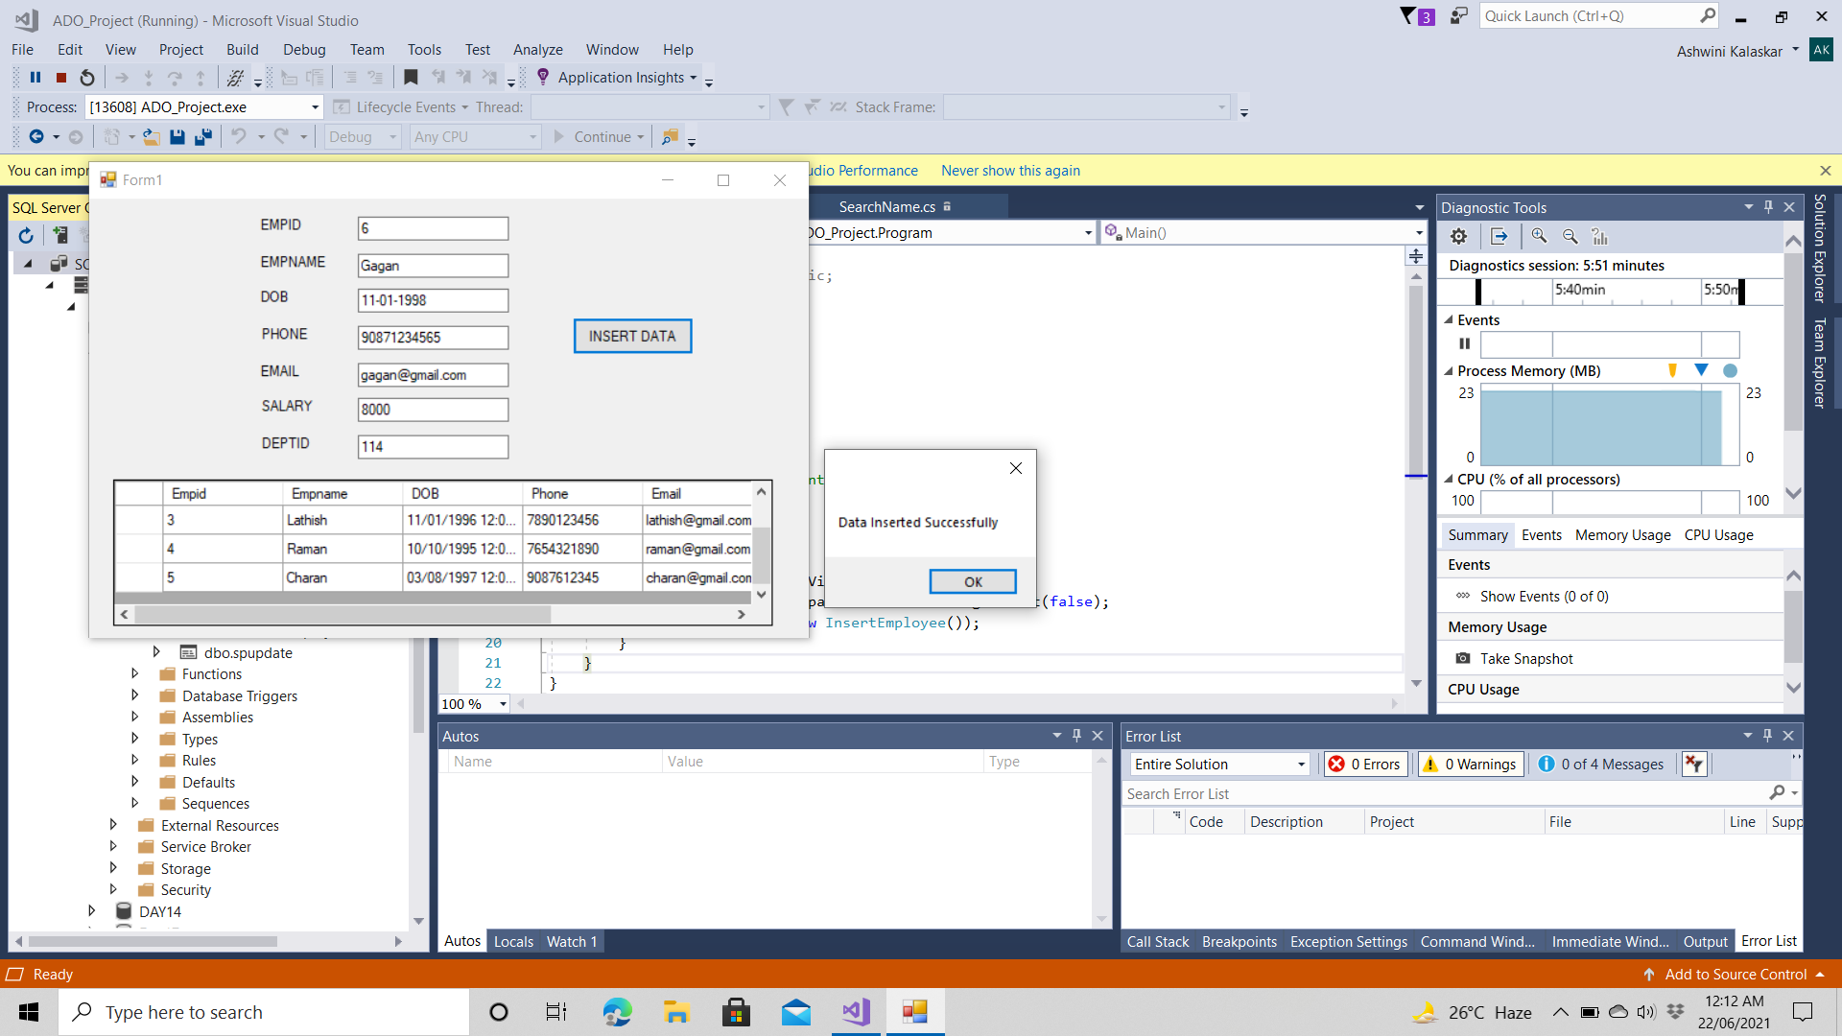
DATA INSERTED OUTPUT FOR EMPLOYEE:

Slide 25
INSERT DEPARTMENT.CS:
using ADO_Project.Model;
using System;
using System.Collections.Generic;
using System.ComponentModel;
using System.Data;
using System.Drawing;
using System.Linq;
using System.Text;
using System.Threading.Tasks;
using System.Windows.Forms;
namespace ADO_Project
{
public partial class InsertDept : Form
{
Logic ob;
public InsertDept()
{
InitializeComponent();
ob = new Logic();
}
private void InsertDept_Load(object sender, EventArgs e)
{
dataGridView1.DataSource = ob.getAllDataDept();
}

Slide 26
private void btninsert_Click(object sender, EventArgs e)
{
Department d = new Department();
d.Deptid = Convert.ToInt32(tbdid.Text);
d.Deptname = tbdname.Text.ToString();
d.Deptlocation = tbloc.Text.ToString();
d.Managerid = Convert.ToInt32(tbeid.Text);
string msg = ob.addspDept(d);
MessageBox.Show(msg);
dataGridView1.DataSource = ob.getAllDataDept();
tbdid.Text = "";
tbdname.Text = "";
tbloc.Text = "";
tbeid.Text = "";
}

Slide 27
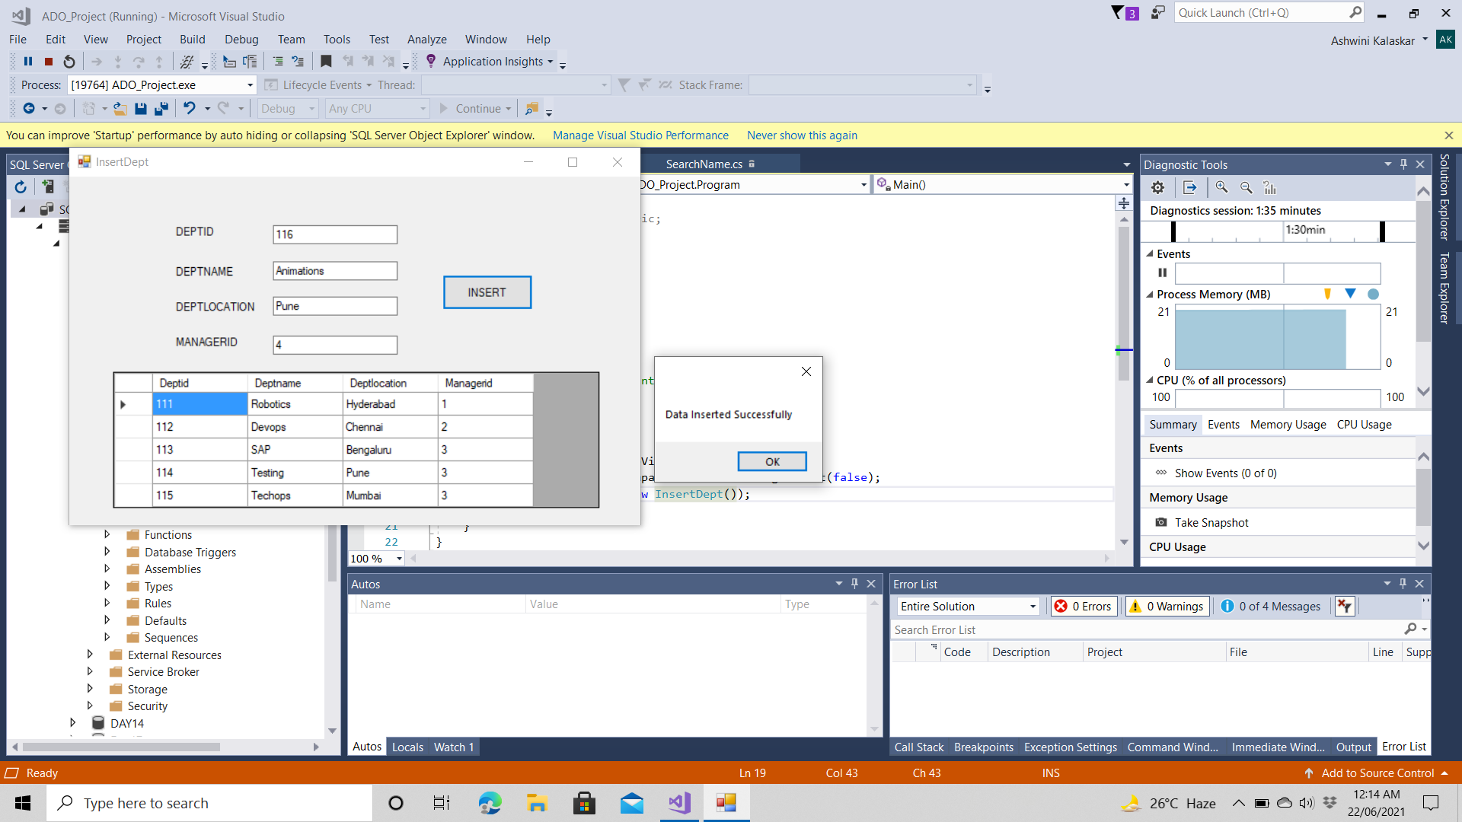
OUTPUT OF DATA INSERTED TO DEPARTMENT:

Slide 28
SEARCH BY NAME.CS:
using ADO_Project.Model;
using System;
using System.Collections.Generic;
using System.ComponentModel;
using System.Data;
using System.Drawing;
using System.Linq;
using System.Text;
using System.Threading.Tasks;
using System.Windows.Forms;
namespace ADO_Project
{
public partial class SearchName : Form
{
Logic ob;
public SearchName()
{
InitializeComponent();
ob = new Logic();
}
private void SearchName_Load(object sender, EventArgs e)
{
dataGridView1.Visible = false;
}

Slide 29
private void btnsearch_Click(object sender, EventArgs e)
{
dataGridView1.Visible = false;
string name = tbename.Text.ToString();
Employee emp = ob.searchName(name);
if (emp == null)
{
MessageBox.Show("No data present");
}
else
{
List<Employee> li = new List<Employee>();
li.Add(emp);
MessageBox.Show("Data is present");
dataGridView1.Visible = true;
dataGridView1.DataSource = li;
}
tbename.Text = "";
}
}
}

Slide 30
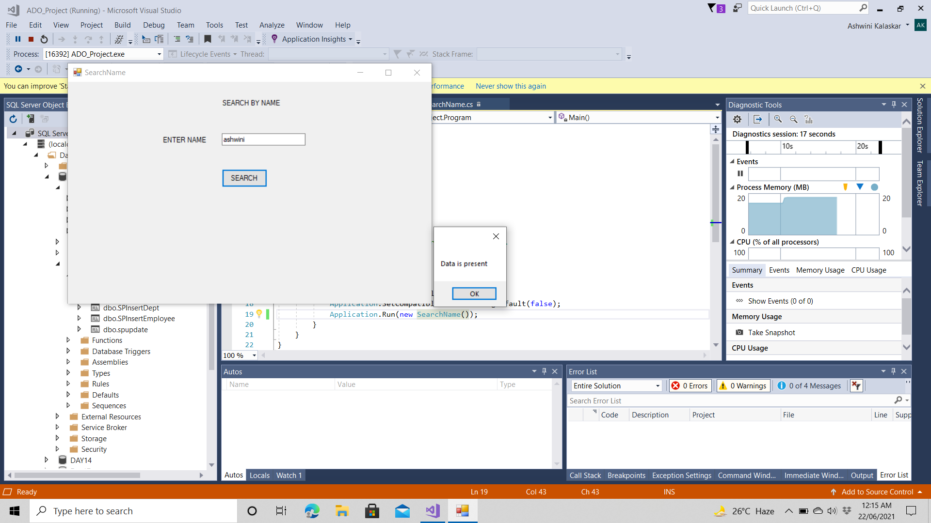
SEARCH BY NAME OUTPUT:

Slide 31
SEARCH BY SALARY :
using ADO_Project.Model;
using System;
using System.Collections.Generic;
using System.ComponentModel;
using System.Data;
using System.Drawing;
using System.Linq;
using System.Text;
using System.Threading.Tasks;
using System.Windows.Forms;
namespace ADO_Project
{
public partial class SearchSalary : Form
{
Logic ob;
public SearchSalary()
{
InitializeComponent();
ob = new Logic();
}
private void SearchSalary_Load(object sender, EventArgs e)
{
dataGridView1.Visible = false;
}

Slide 32
private void btnsearch_Click(object sender, EventArgs e)
{
float sal = float.Parse(tbsalary.Text);
Employee emp = ob.searchSalary(sal);
if (emp == null)
{
MessageBox.Show("NO Data Present");
}
else
{
List<Employee> li = new List<Employee>();
li.Add(emp);
MessageBox.Show("Data is Present");
dataGridView1.Visible = true;
dataGridView1.DataSource = li;
}
tbsalary.Text = "";
}
}
}

Slide 33

SEARCH BY SALARY OUTPUT:

Slide 34
UPDATE EMPLOYEE.CS:
using ADO_Project.Model;
using System;
using System.Collections.Generic;
using System.ComponentModel;
using System.Data;
using System.Drawing;
using System.Linq;
using System.Text;
using System.Threading.Tasks;
using System.Windows.Forms;
namespace ADO_Project
{
public partial class UpdateEmployee : Form
{
Logic ob;
public UpdateEmployee()
{
InitializeComponent();
ob = new Logic();
}
private void UpdateEmployee_Load(object sender, EventArgs e)
{
dataGridView1.DataSource = ob.getAllData();
label2.Visible = false;
label3.Visible = false;
label4.Visible = false;
label5.Visible = false;
label6.Visible = false;
label7.Visible = false;
tbename.Visible = false;
tbdob.Visible = false;
tbphone.Visible = false;
tbemail.Visible = false;
tbsalary.Visible = false;
tbdid.Visible = false;
btnupdate.Visible = false;
}

Slide 35
private void btncheck_Click(object sender, EventArgs e)
{
int id = Convert.ToInt32(tbeid.Text);
Employee emp = ob.search(id);
if (emp == null)
{
MessageBox.Show("Enter the valid EMPID as this doesn't exists");
}
else
{
label2.Visible = true;
label3.Visible = true;
label4.Visible = true;
label5.Visible = true;
label6.Visible = true;
label7.Visible = true;
tbename.Visible = true;
tbdob.Visible = true;
tbphone.Visible = true;
tbemail.Visible = true;
tbsalary.Visible = true;
tbdid.Visible = true;
btnupdate.Visible = true;
}
}

Slide 36
private void btnupdate_Click(object sender, EventArgs e)
{
Employee emp = new Employee();
emp.Empid = Convert.ToInt32(tbeid.Text);
emp.Empname = tbename.Text.ToString();
emp.DOB = tbdob.Text.ToString();
emp.Phone= Convert.ToInt64(tbphone.Text);
emp.Email = tbemail.Text.ToString();
emp.Salary=float.Parse(tbsalary.Text);
emp.Deptid = Convert.ToInt32(tbdid.Text);
ob.updatesp(emp);
tbeid.Text = "";
tbename.Text = "";
tbdob.Text = "";
tbphone.Text = "";
tbemail.Text = "";
tbsalary.Text = "";
tbdid.Text = "";
dataGridView1.DataSource = ob.getAllData();
label2.Visible = false;
label3.Visible = false;
label4.Visible = false;
label5.Visible = false;
label6.Visible = false;
label7.Visible = false;
tbename.Visible = false;
tbdob.Visible = false;
tbphone.Visible = false;
tbemail.Visible = false;
tbsalary.Visible = false;
tbdid.Visible = false;
btnupdate.Visible = false;
btncheck.Visible = true;
}
}
}

Slide 37
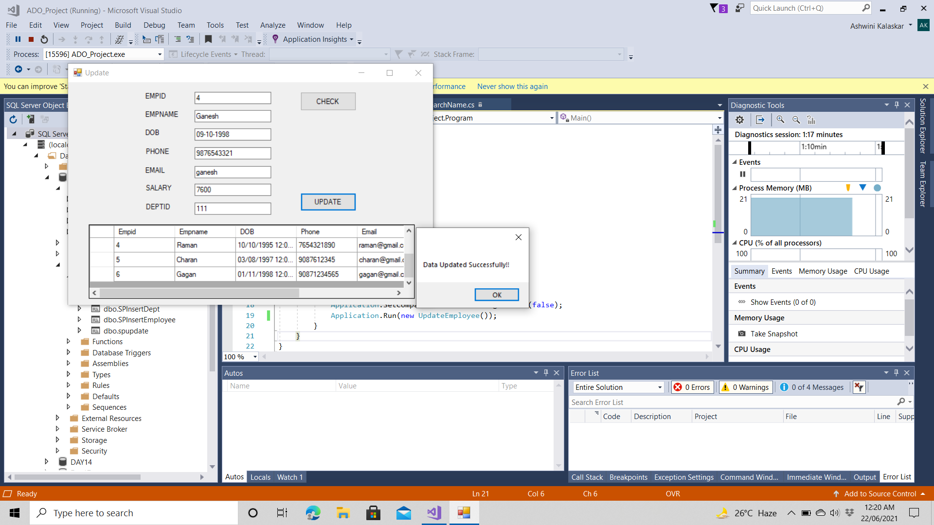
UPDATE EMPLOYEE DETAILS OUTPUT:

Slide 38
DELETE EMPLOYEE DETAILS.CS:
using ADO_Project.Model;
using System;
using System.Collections.Generic;
using System.ComponentModel;
using System.Data;
using System.Drawing;
using System.Linq;
using System.Text;
using System.Threading.Tasks;
using System.Windows.Forms;
namespace ADO_Project
{
public partial class DeleteEmployee : Form
{
Logic ob;
public DeleteEmployee()
{
InitializeComponent();
ob = new Logic();
}
private void DeleteEmployee_Load(object sender, EventArgs e)
{
dataGridView1.DataSource = ob.getAllData();
dataGridView1.Visible = false;
}

Slide 39
private void btndelete_Click(object sender, EventArgs e)
{
int id = Convert.ToInt32(tbeid.Text);
bool es = ob.check(id);
if (es)
{
string msg = ob.deletesp(id);
if (msg != null)
{
MessageBox.Show(msg);
dataGridView1.Visible = true;
dataGridView1.DataSource = ob.getAllData();
}
else
{
MessageBox.Show("unable to fetch data....");
}
}
else
{
MessageBox.Show("Enter valid EmpID");
}
}
}
}

Slide 40

DELETE EMPLOYEE ID OUTPUT:

Slide 41
DETAILS OF MANAGER.CS:
using ADO_Project.Model;
using System;
using System.Collections.Generic;
using System.ComponentModel;
using System.Data;
using System.Drawing;
using System.Linq;
using System.Text;
using System.Threading.Tasks;
using System.Windows.Forms;
namespace ADO_Project
{
public partial class DetailsOfManager : Form
{
public DetailsOfManager()
{
InitializeComponent();
}
private void DetailsOfManager_Load(object sender, EventArgs e)
{
Logic ob = new Logic();
dataGridView1.DataSource = ob.DetailsOfManager();
}
}
}

Slide 42
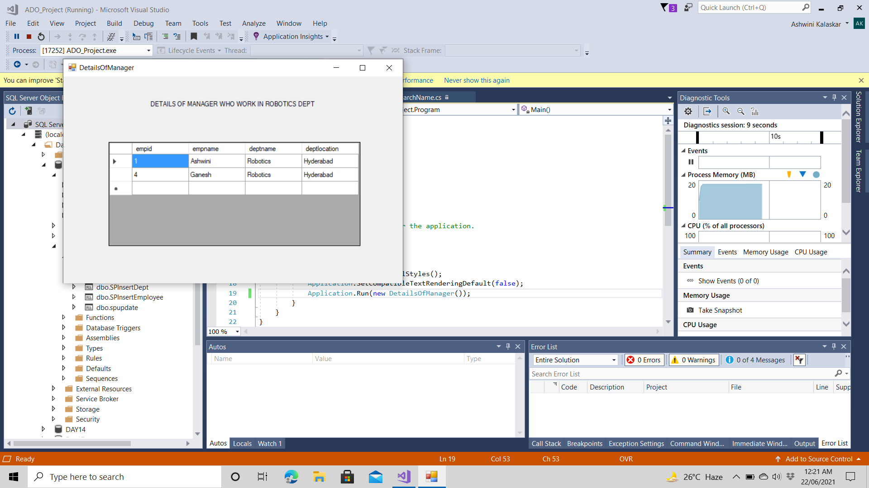
OUTPUT OF MANAGER WHO WORK IN ROBOTICS DEPT:

Slide 43
PROCEDUERS:
create procedure SPInsertEmployee
(@eid int,@ename varchar(50),
@dob date,@phone bigint,
@email varchar(50),
@salary float,
@did int)
As begin
insert into dbo.Employee values(@eid,@ename,@dob,@phone,@email,@salary,@did);
end

Slide 44
create procedure spupdate
(@eid int,
@ename varchar(50),
@dob date,
@phone bigint,
@email varchar(50),
@salary float,
@did int)
As begin
update dbo.Employee
set EMPNAME = @ename, DOB = @dob, PHONE = @phone, EMAIL= @email, SALARY = @salary, DEPTID= @did where EMPID = @eid;
end

Slide 45


